Slide 1
Calculating the Economics of Inspections
By Ed Weller
Barry Boehm: He noted that the defect repair cost increased by a factor of ten for each successive stage of defect removal. A defect that costs one hour to find, fix, and retest in unit test, would cost ten hours in the next stage, 100 hours two stages later (system test) and 1000 hours after shipping. In my experience, I have not seen the producer costs increase at this rate, but have seen 30:1 to 50:1 ratios between inspection cost and system test or customer defect repair costs (where the inspection cost is in the two-hour range).
Source: http://www.stickyminds.com/sitewide.asp?Function=edetail&ObjectType=ART&ObjectId=3161

Slide 2
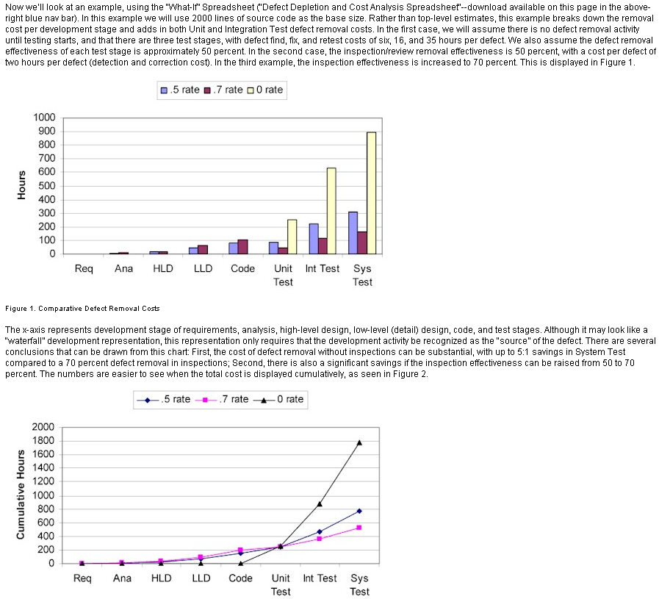
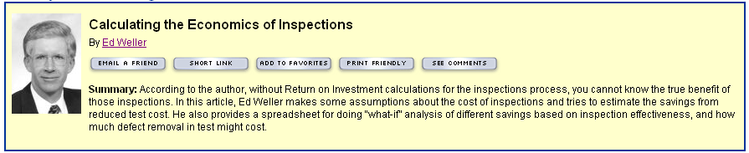
Calculating the Economics of Inspections
By Ed Weller

Slide 3
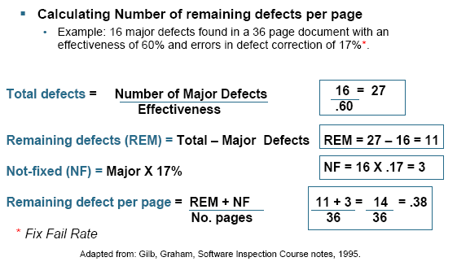
Calculate Number of Remaining Defects Per Page

